Slide 1
Positive Behaviour Supports
Functions of Behaviour

Slide 2
Functional Behaviour Assessment Steps
Decide if a intervention is warranted
Develop a personal profile
Define the target behaviour
Conduct a functional behaviour interview
Conduct direct observations
Use setting events checklist
Form hypothesis
Design an support plan (prevent, teach and respond)
Evaluate plan

Slide 3

Interview
Conducted by the person who will analyze all the data and develop the support plan
Uses a concrete definition of the behaviour, thus minimizing unfocussed conversations

Slide 4
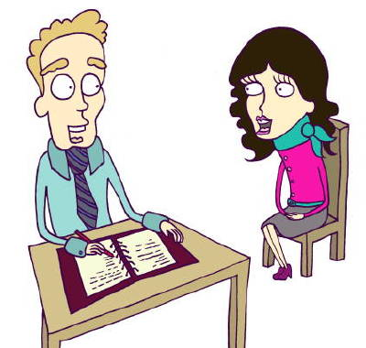
Interview
Emphasizes the student’s routines, events, and areas staff have control over
Guides the team to look at predictors and patterns
Many commercial products
Student, the team as a group, individual team members or family could be interviewed

Slide 5

Interview
Typical questions:
When, and under what circumstances (setting, staff, activity, time of day) is the behaviour most likely to occur?
What happens just before the behaviour occurs? Just after the behaviour occurs?
Why do you think the behaviour occurs?

Slide 6

Interview
Typical questions:
What skills does the student have to get their needs met appropriately?
Are there circumstances in which the behaviour never occurs? What are they?
What interventions have been tried? What works? What doesn't’t work?
What activities, objects or events are reinforcing to the student?

Slide 7
Functional Behaviour Assessment
Involves a problem solving process
Includes team work
Looks at the “big” picture (ecological and environment context) and immediate triggers and consequences
Believes behaviour is communication
Is there a medical, physical or emotional reason for the behaviour?
Is there a problem with the curriculum or instructional methods, or physical or social environment?

Slide 8

Functions of Behaviour
Gaining access to materials, people or activities
Avoiding, escaping, or protesting

Slide 9

Avoiding / escaping / protesting
Student perceives activity (academic or social) as too easy, boring, of no use, uninteresting) and wants to avoid
Student wants to escape social demands or person
Student wants to get away from a particular type of environment (too noisy, too much light, irritating textures or colours...)

Slide 10

Gaining access to materials, people or activities
Seeking various levels or type of attention from peers or adults
Wants a desired object or activity
Wants a particular social attention

Slide 11

Hypothesis
1-2 summary statements
Based on the data (direct observations, interviews, setting events)
Addresses the relation between the target behaviour, the function of the behaviour (communicative intent) and the antecedent / setting event)

Slide 12

Hypothesis
Includes environmental factors
Informs the development of the support plan
All team members need to consider it logical

Slide 13

Examples of Hypothesis Statements
Sally makes loud noises when she is given a difficult assignment. She does this to get out of social studies.
When Ali does not sleep well, and is left alone, she hits herself. She does this to get attention.

Slide 14

Activity
Read assigned text.
Be prepared to discuss:
The process
EA role
Supports / strategies for students
What else do you want to discuss or needs clarifying?

